Slide 1
The Do-s and Don’t-s of Effective Multi-Media Presentations
Mr. Hapke / Mr. van den Broek ADST 8 – Period 1

Slide 2
Introduction
Hello. My name is Troy and welcome to my presentation about Vancouver. I have lived in Vancouver my entire life. Vancouver was founded in 1886, but before that, Vancouver was known as Granville which is really interesting because today, there is a still a street called Granville as well as Granville Island.
DON’T
Notes:
Boring title
Don’t read out every word

Slide 3
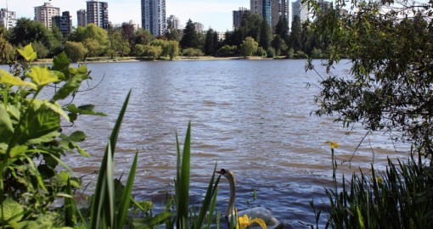
What Makes Stanley Park GREAT!
Vancouver Aquarium – belugas, sea otters
Sea Wall – bicycle, roller blade, walk, run
Lion’s Gate Bridge – amazing view of the narrows
Third Beach Concession – Hot dogs, burgers, fries
Lost Lagoon – ducks, view, fountain
DO
Notes:
Too many colours.
Avoid pool colour schemes/combinations
Remember that what looks good on your monitor does not necessarily look good on the big screen.

Slide 4
What Makes Stanley Park GREAT!
Vancouver Aquarium – belugas, sea otters
Sea Wall – bicycle, roller blade, walk, run
Lion’s Gate Bridge – amazing view of the narrows
Third Beach Concession – Hot dogs, burgers, fries
Lost Lagoon – ducks, view, fountain
DON’T
Notes:
Too many colours.
Avoid pool colour schemes/combinations
Remember that what looks good on your monitor does not necessarily look good on the big screen.

Slide 5
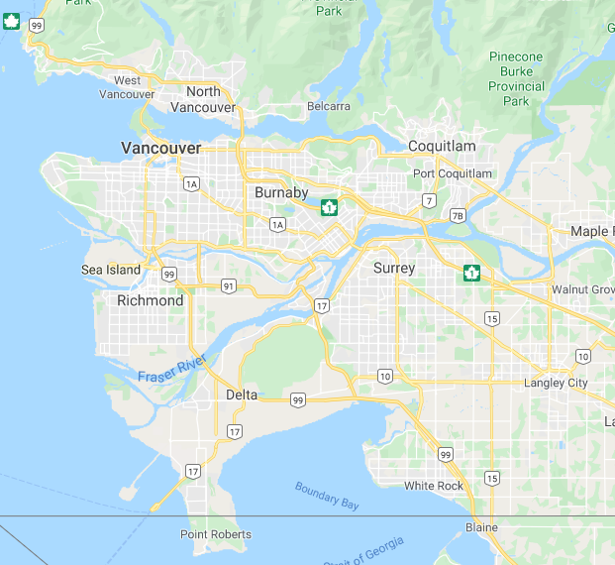
Arrivals/Departures
BC Ferries – Horseshoe Bay To Nanaimo/Bowen Island
Trans Canada Hwy To Kamloops then Calgary
YVR Airport Domestic & International Flights
BC Ferries – Tsawwassen To Nanaimo/Victoria
Peace Arch Border Hwy 99/ I-5 to Seattle

Slide 6
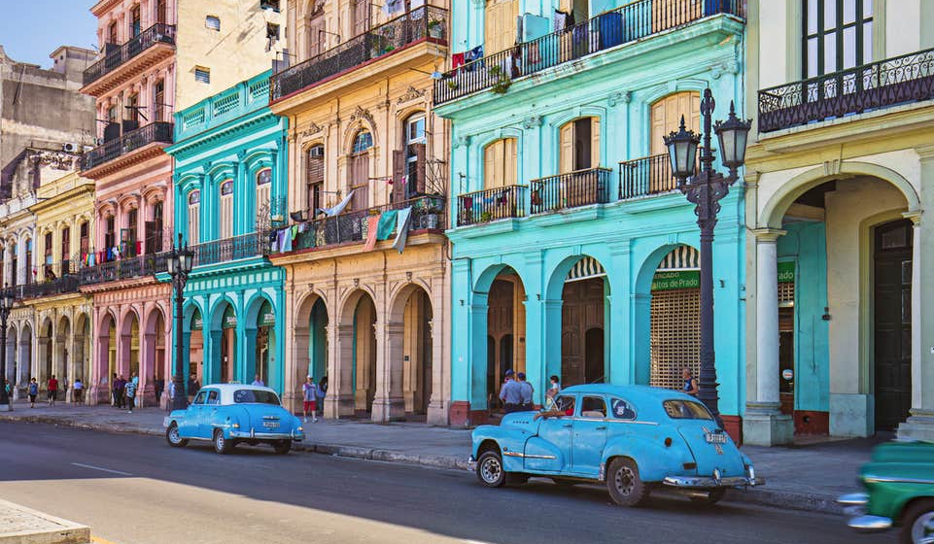
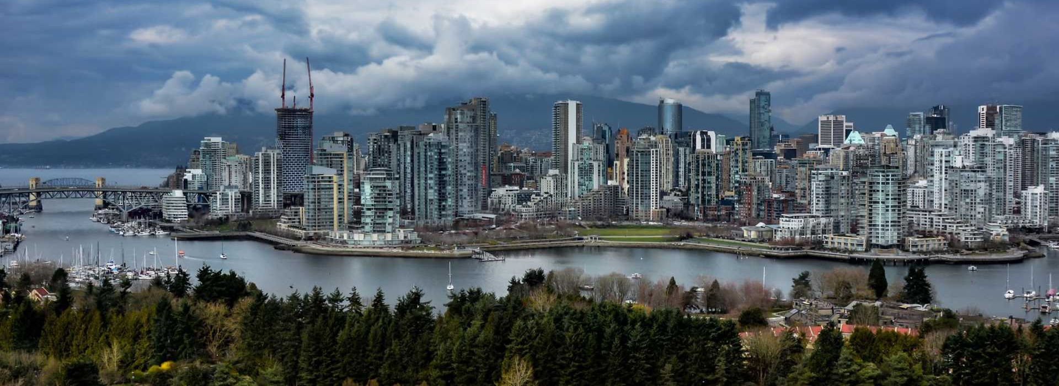
Vancouver vs. Havana
Modern skyscrapers (Many new in last 30 years) | Historical Architecture (French, Spanish, European influences)
Modern new cars (Variety of brands) | 1950’s era cars still in use
Distinct seasons (cool & rainy: fall – spring) | Warm summery weather all year around

Slide 7
The Grouse Grind: TOP 10
The Grouse Grind is a 2.9-kilometre trail up the face of Grouse Mountain, commonly referred to as “Mother Nature’s Stairmaster.”
DON’T
Going to do the Grind? Here is a list of the top ten things to take with you for a safe hike:
Hiking poles
Snacks
First-Aid Kit
Trail Map
Cellphone
Flashlight
Water
Hiking Boots
Extra Clothes
Pocket Knife

Slide 8
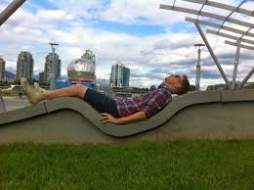
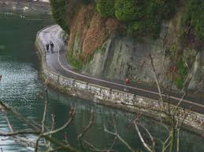
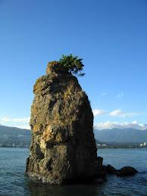
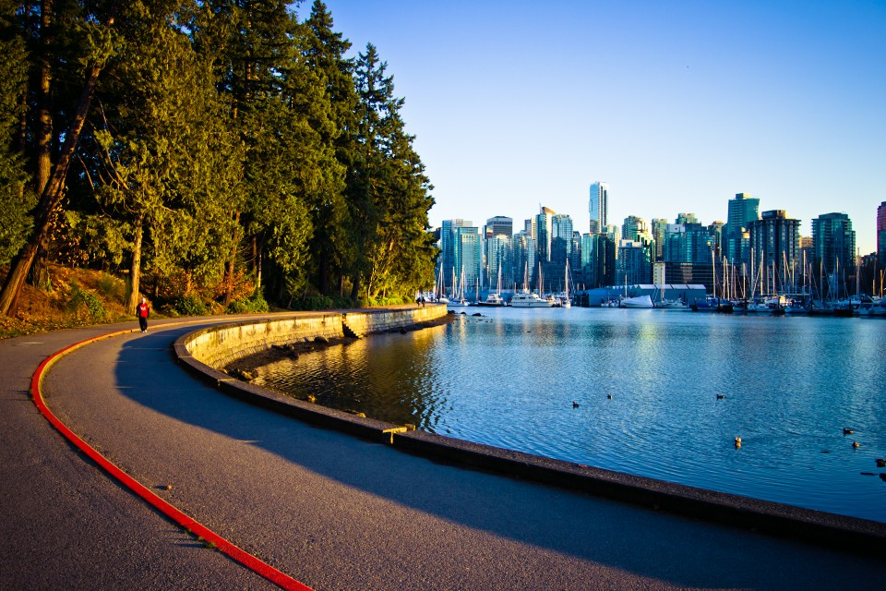
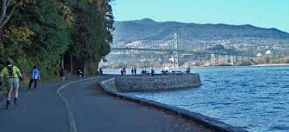
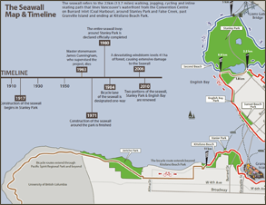
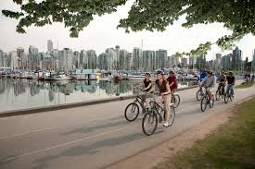
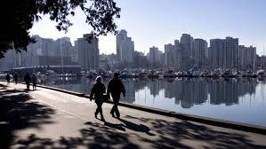
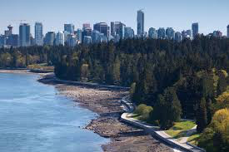
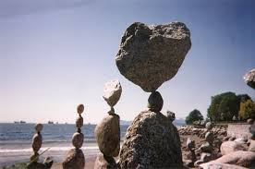
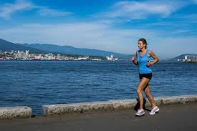
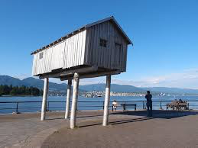
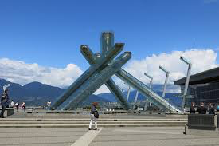
SEA WALL SHOTS: SEE & BE SEEN
DON’T
Notes:
To much animation.
Test your animation, make sure it looks good, and each item is in the correct order.

Slide 9
Oder Tid Bits: Speling Ehrers
Ofen times presentors do not proffread 4 grammer errers or dont never pay atention to they’re spell chequer witch can result in alot of blaring mistaks that will distract your audience, expeciallity ur teach.
Fer reaLL.
DON’T
If you see the red zig-zag, right click to see the suggested spellings!
Notes:
Max six bullet points.
Images make it visually interesting and memorable

Slide 10
Conclusions: No Memes
This is not the tone you want to set with your last slide!
No “The End” Slide!
Wrap up your thoughts with a conclusion!
DON’T
Notes:
Max six bullet points.
Images make it visually interesting and memorable

Slide 11
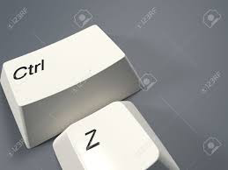
Important DOs:
Use font sizes at least 28 for text, 32 for titles.
FYI: This is Calibri / 32 and 44.
Use colour for specific meaning (Red/Green)
Keep Location and Style consistent (Title, Background and Content)
Enter the Slide Show (F5) to do a test run.
Slides in the correct order?
Transitions / Animations in the correct order?
Test: Can you read it from the back of the room?
Notes:
Max six bullet points.
Images make it visually interesting and memorable

Slide 12
Your Assignment:
Make a 10 Slide PowerPoint
Choose a school appropriate topic
8 created properly (The Good)
2 as ugly as possible (The Bad and the Ugly!)
Though these are bad, they must stay on-topic!
Don’t have to be the last 2 slides.
5-10 items / slide (bullets/table rows/boxes/etc.)
5-10 words / item (No paragraphs allowed!)
Use a variety of slide formats

Slide 13
Your Assignment:
Begin with a Title Slide
Topic, Name, Period #, At least 1 Graphic
Beginning: Next couple slides introduce the theme
Middle: Cover the most important content
End: Find a nice way to wrap up the topic
The End / Questions? is not acceptable (Even as one of your bad slides)
All slides relate to the theme
1-3 Graphics relate to the current slide’s topic
Each slide has a title at the top

