Slide 1
Add a randomizer:

Slide 2
Add code to the Sub wonky(i As Integer)
After we have added the old number (that’s displayed on the button)
Generate a new number for next click
Display it

Slide 3
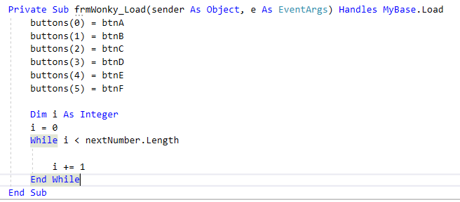
Give the buttons random numbers on Load
Use a loop to run through and give all of the integers and buttons a value.
Basic loop: Needs an index (i) that goes from 0 to 5.

Slide 4
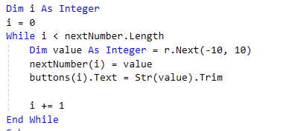
Add the randomization code (Like Slide 2!)

Slide 5
For Fun: Randomize the colour of the button
Add this to wonky(i)
8-Bit color uses the values from 0 to 255
RGB color is: Red, Green, Blue.
FYI: r.Next will generate a number smaller than the second number…
ie: less than 256.

